Slide 1
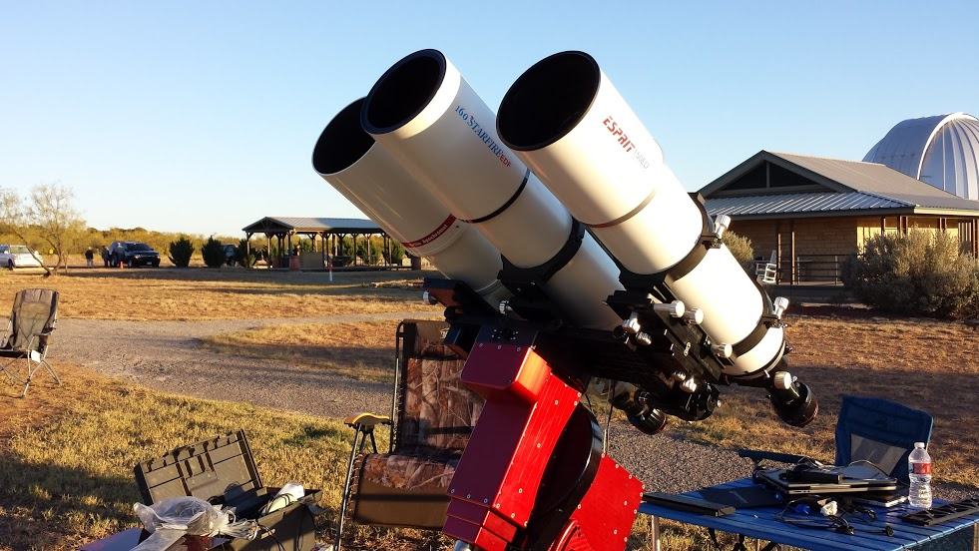
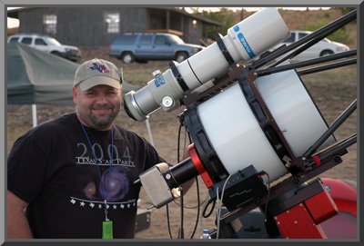
Topic: “Acquiring Great Data”
by Jay Ballauer
FWAS - APSIG
February 2020

Slide 2
Personal Astronomy Timeline
YEAR | EVENT | PRIMARY GEAR | COMMENTS
1997 | First Telescope First Astroimage – Comet Hale-Bopp | Meade LX50 | Dedicated observer but dabbled in film imaging
2000 | Obsessive film imaging First autoguider | Nikon F2 system Meade LX200
2001 | Constructed Ballauer Observatory First CCD photos | SBIG STV TAK FS-78 | Astronomy.com forum moderator
2003 | CCD Imaging breakthrough First RGB images First webcam planetary images | SBIG ST-7E Celestron CGE Tak FSQ-106 | Seeking the dark skies! Copperbreaks Star Walks
2004 | Film dies/CCD reigns First HaRGB images 3RF formed | Canon 300D DSLR Tak NJP mount SBIG STL-6303e SBIG STL-11000m | Attended inaugural AIC BEST Deep Sky photo at TSP Buying my Airstream
2005 | First mapped color images | Paramount ME RCOS 12.5” RC | First print publications
2006 | Marriage and family Consulting & mentoring | Tak TOA-150 AP-900 mount | APOD Sky and Telescope 1st place
2016 | Conley Observatory at CSAC | FLI PL-16803 Celestron C-14
2019 | CCD dies/CMOS reigns | QHY163c QHY600m | CCD is dead!

Slide 3
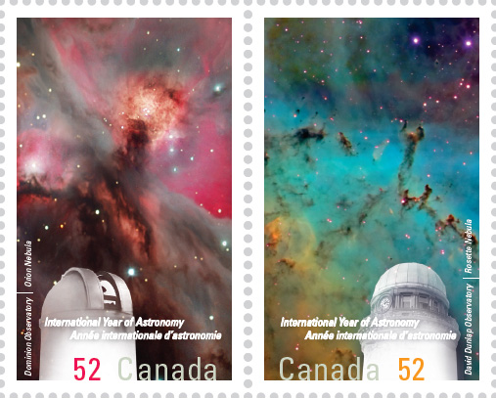
Agenda
Topic – “Acquiring Great Data”
  Introduction
  Workflow Step 1: Gear, Setup, & Environment
  Workflow Step 2: Calibration
  Workflow Step 3: Light Frames
  Workflow Step 4: Pre-Processing Considerations
  Workflow Step 5: Post-Processing Considerations
  Summary

Slide 4
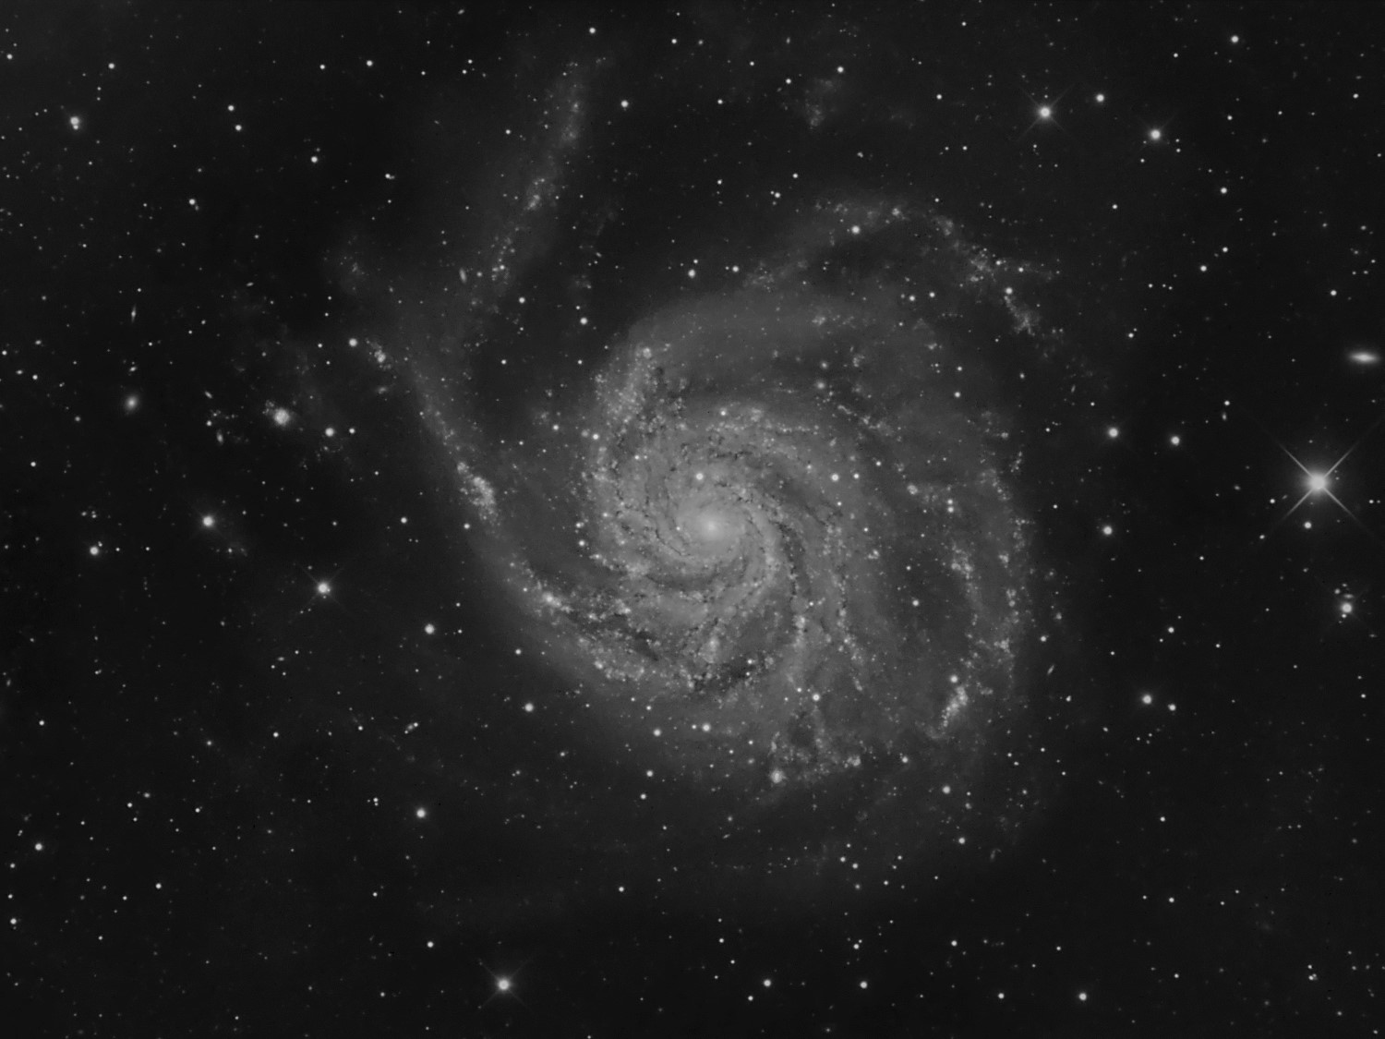
Introduction: Acquiring Great Data…
Simply put, great images happen more as a result of good data acquisition than it does great processing skills. Conversely, nothing destroys an image like bad conditions and poor execution.

Slide 5
Workflow 1: Gear, Environment & Setup
What decisions are to be made with regard to gear?
    CCD vs. CMOS?
    Permanent or portable?
    Dark sky or city imaging?
    Narrowband?
    OSC vs. grayscale?
    Long or short focal length?
    System speed vs. image scale?
    Auto-guide or unguided?
Are these decisions driven by goals or your budget?
    I think we know the answer to that…
    So priority in gear becomes important

Slide 6
Choosing your gear wisely
    Mounts, optics, cameras, etc.
      Choose optics and camera image scale to match your mount’s capabilities
      Choose a camera that fits your optics
      CCD or CMOS astro cameras vs. DSLRs
    Adapters, hardware, cables, computers, hubs, power supplies, etc.
Controlling your gear’s performance
    Good maintenance
      Collimation
    Great setups – polar alignment, balance, focus, etc.
    Understanding your gear’s capabilities and employing fixes.
      PEC?
      T-Point modelling?

Slide 7
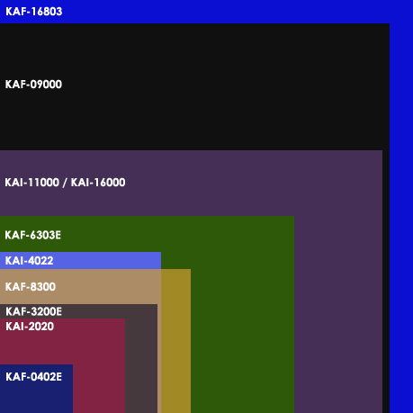
How Big is Your Canvas?
- Phil Jones, www.visualuniverse.org

Slide 8
Camera: QHY 600M
Sensor Size: Full frame (24 x 36mm)
Sensor: Sony IMX-455; back-illuminated CMOS
Resolution: 9576 x 6388 pixels (60 megapixels grayscale)
Pixel Size: 3.76 microns
Quantum Efficiency (QE): Estimated 92% at 530 nm peak; 75% at 656.3nm (h-alpha)
A/D: 16-bit (1x1); 18-bit (2x2); 19-bit (3x3)
Full Well Capacity: >51ke- (1x1); >204ke- (2x2); >408ke- (3x3)
Read Noise: 1.0e- to 3.7e-
Typical Field of Views...

Slide 9
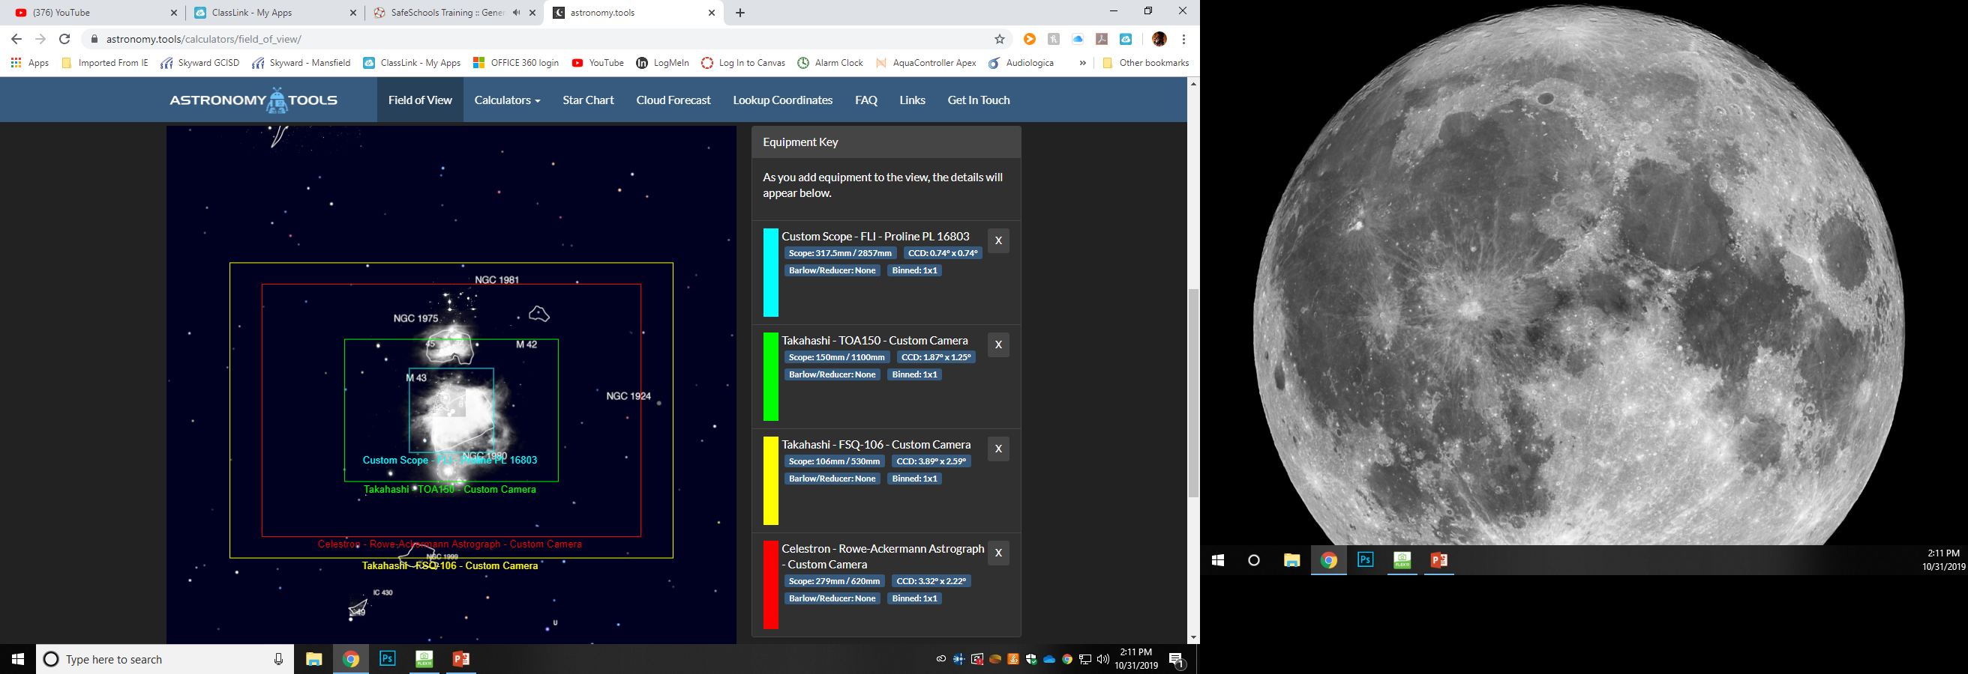

Slide 10
QHY 600 Summary:
Pros:
The first 16-bit CMOS chip camera
Quantum efficiency is nearly the best in the game, especially at h-alpha line
Huge full-well capacities per unit pixel size
Small pixels to mate with shorter focal length instruments
Read noise levels extremely low, allowing shorter exposures
User- adjustable gain settings
Flexibility for deep space imaging or planetary work (in video mode)
Choice between grayscale and OSC varieties
Smaller footprint for RASA/Hyperstar systems
Smaller camera weight than typical CCD cameras
Cons:
File sizes will requires heavy computing power and storage capacities
Processing time is much longer than data from typical cameras
Drivers are QHY; less reliable and lack of camera control options
Clouds prevent consistent use…doh!

Slide 11
Imaging Environment
One of the best ways to improve data collection is to optimize the imaging area.
    The vast majority of bad seeing happens within 30 ft. of your location.
    Acclimatize your optics – use a fan
    Set up in the grass and away from buildings
    Focusing shifts due to temperature
    Image in DARK SKIES!
What does this mean for your workflow?
    Making smart target choices
    Hits to SNR
      Loss due to higher sky background levels
      Loss due to photon scatter (bad seeing)
      How does this affect mosaics? Same evening? Over Multiple nights?
    Acquisition priorities

Slide 12
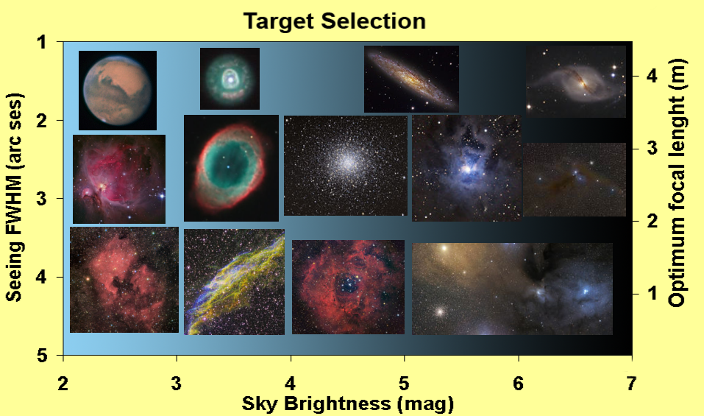
1.) Making smart target choices…
Choose wise targets for your given conditions and equipment…
- Johannes Schedler, www.panther-obseratory.com

Slide 13
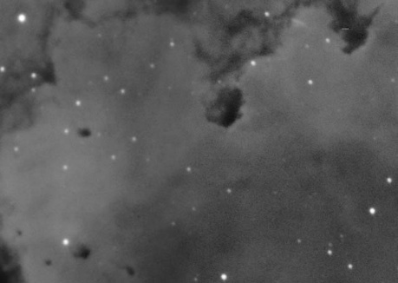
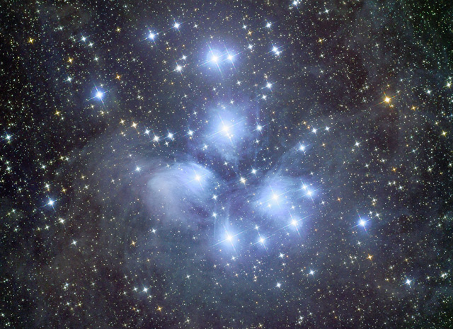
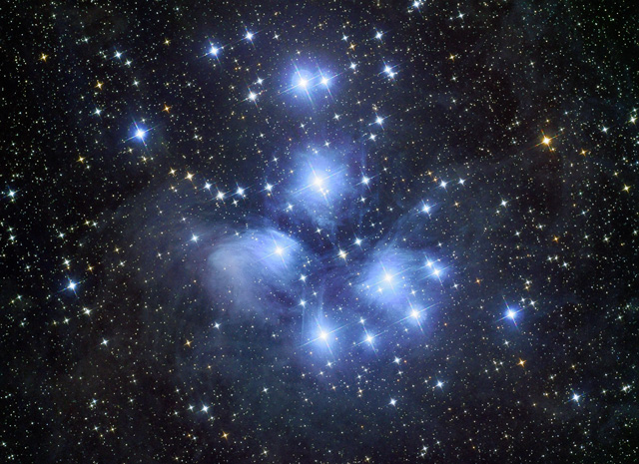
2.) Hits to SNR…
Maximizing SNR is key
…to reveal detail in the shadows - to make the black disappear.
To allow for better sharpening of the image.
150 minutes total
210 minutes total

Slide 14
3.) Acquisition Priorities…
First Order Practices
    Polar alignment
    Balance the mount
    Focusing!!!
    Collimation/optics
    Reduce local seeing effects
    Dark frames!
Second Order Practices
    Good Guiding
    Refocus for filters
    RGB filter balance
    Flat fielding
    Dithering
Third Order Practices
Scope choice matched to object and conditions
Multiple darks, bias, and flat field frames (for all filters)
Using specific combine methods (median, mean, add, Sigma, Min/Max)

Slide 15
Workflow 2: Calibration
  Scaling darks with bias frames for CCDs
  Non-scaled darks for CMOS sensors
  No darks for DSLRs
  Are darks useful or practical? Cooling set-point?
  Effectiveness of flat-field? Is it worth it?
Calibrate and Dither
Scaled Calibration
No Calibrations…
Non-scaled Calibration
Dither only
No Calibrations…
Do Nothing
Bias calibration only

Slide 16
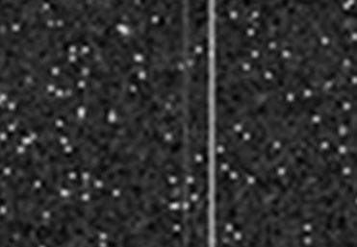
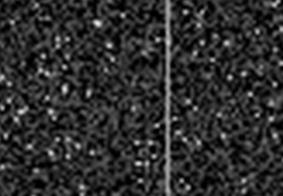
Dark frames…
Removes thermal signal
High-quality dark-frame
library
    Utilize down time
    Use the refrigerator
Single vs. Master Darks
    Cosmic ray hits and noise sources (other than thermal) REQUIRE multiple darks combined into a “master” dark.
    Take many dark frames (10 + for darks) and median combine for masters…20 dark frames or more is not excessive

Slide 17
Bias Frames…
Bias frames are a snap shot of the camera at its “zero” state showing the CCD’s fixed pattern noise.
    For astro cameras, you just set your software to “bias” and it will automatically take the proper exposures.
    For DSLRs, you set the camera to its fastest shutter speed at the ISO you intend to shoot.
Because there is read-out noise in each frame, you must take a TON of bias frames and do a pure average combine to derive a reliable master frame that shows the pattern noise.

Slide 19
“Amp” Glow issues…
With CCDs, objectionable glow comes from the amplifier. This glow tends to grow WITH the dark current.
This may be removed with regular darks (same exposure and temp) or with scaled darks (bias + any dark master frame).
In CMOS, it’s not “amp” glow…just “glow.” This glow is from multiple electronic sources on and off-sensor. It does not “grow” with dark current.
Scaled darks will not work with most CMOS cameras…you need them to match the length, temp, and gain of the light frames.

Slide 20
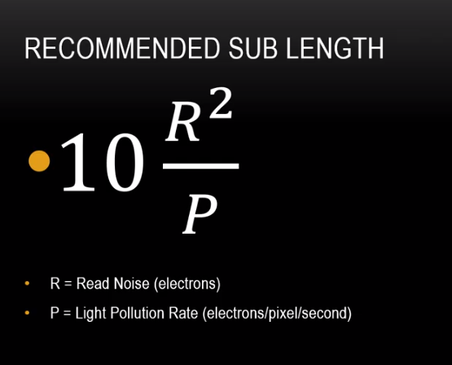
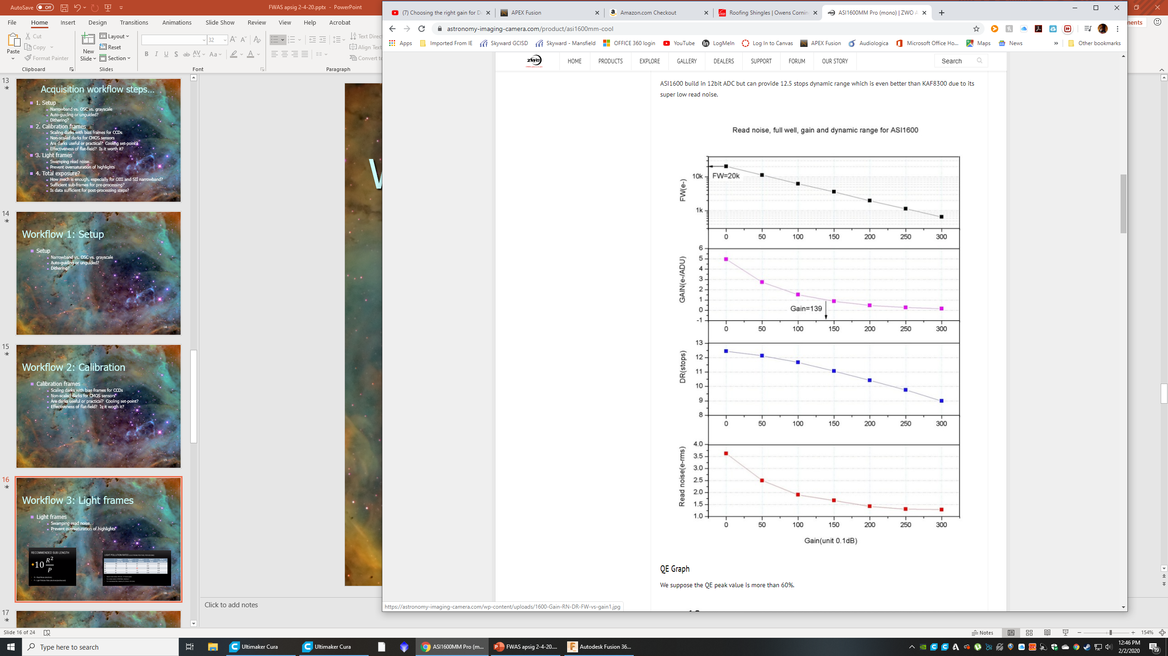
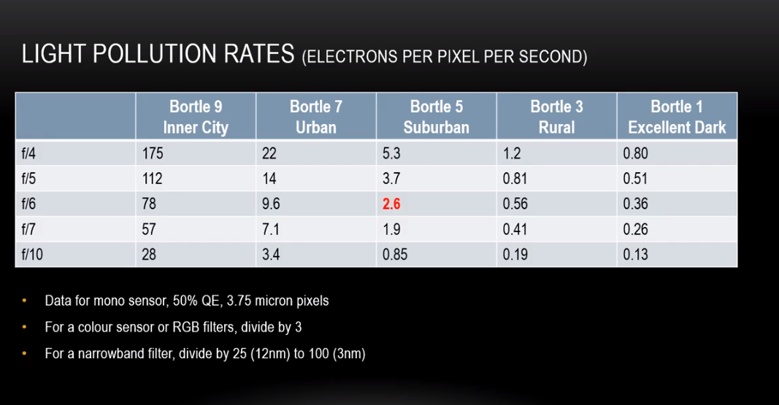
Workflow 3:
Light frames
    Swamping read noise…
    Prevent oversaturation of highlights
    Gain adjustment?

Slide 21
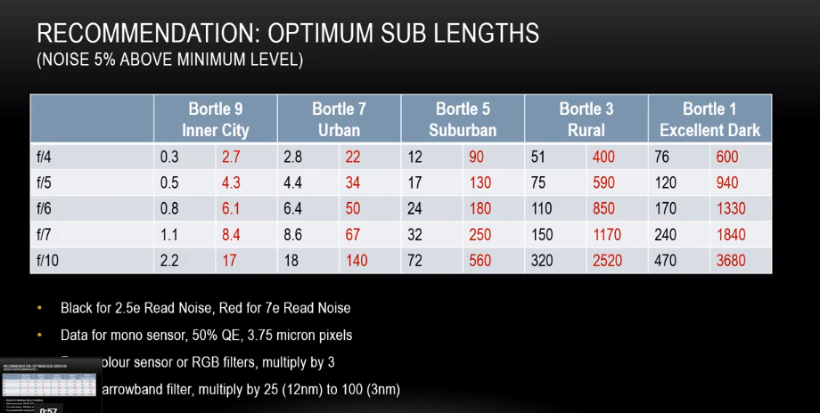

Slide 22
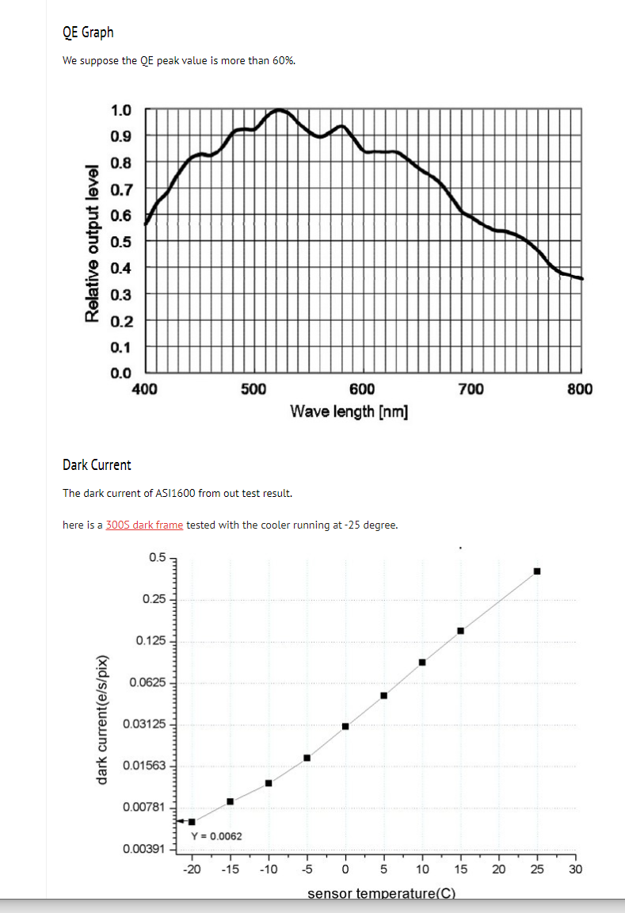
Understanding sensor charts…
ASI 1600m

Slide 23
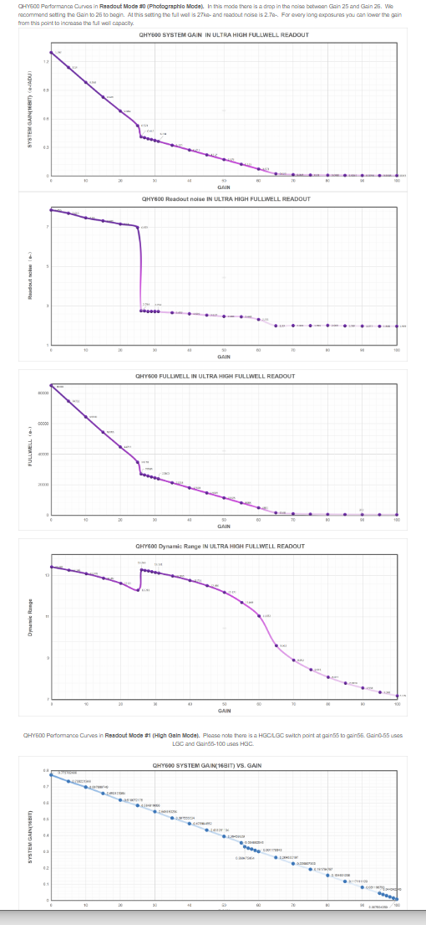
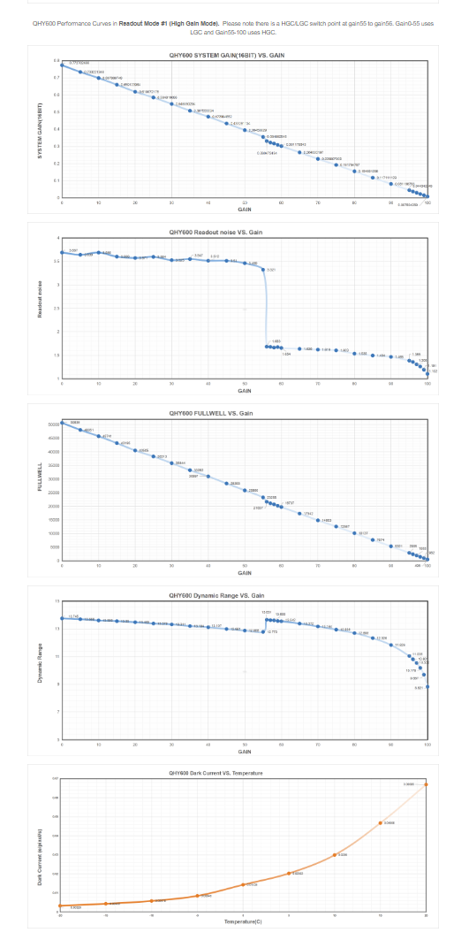
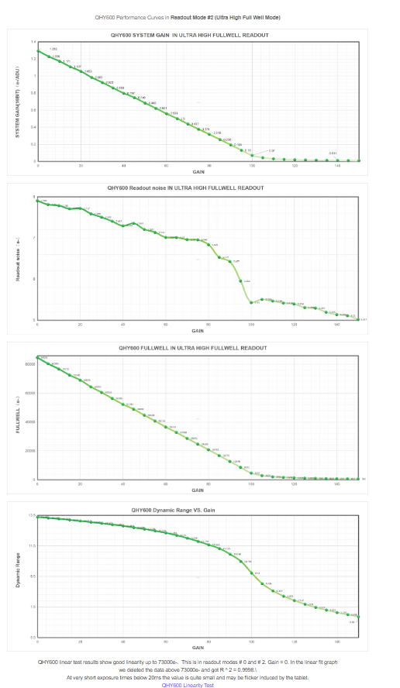
More…
QHY600m

Slide 24
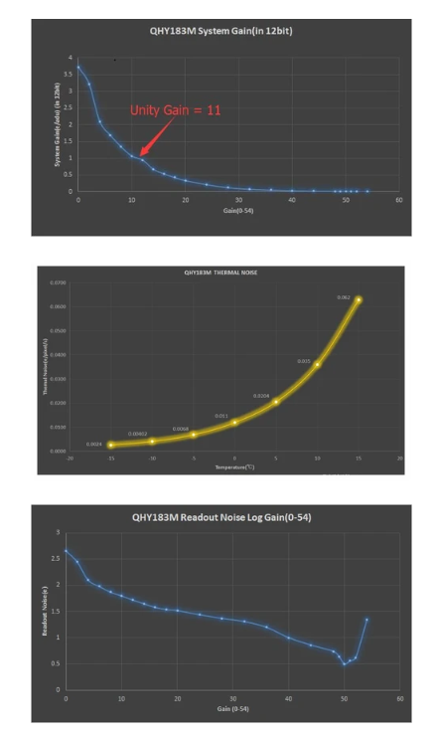
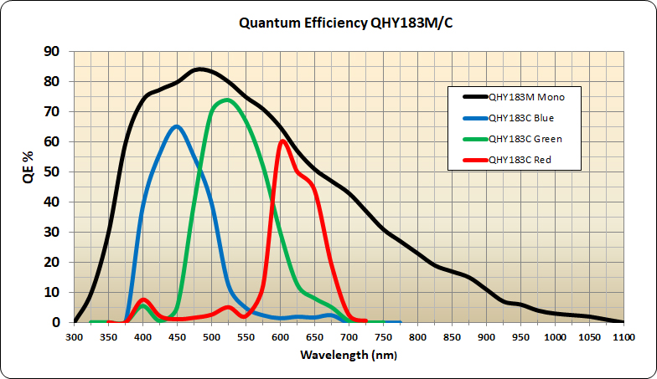
QHY 183m/c

Slide 25
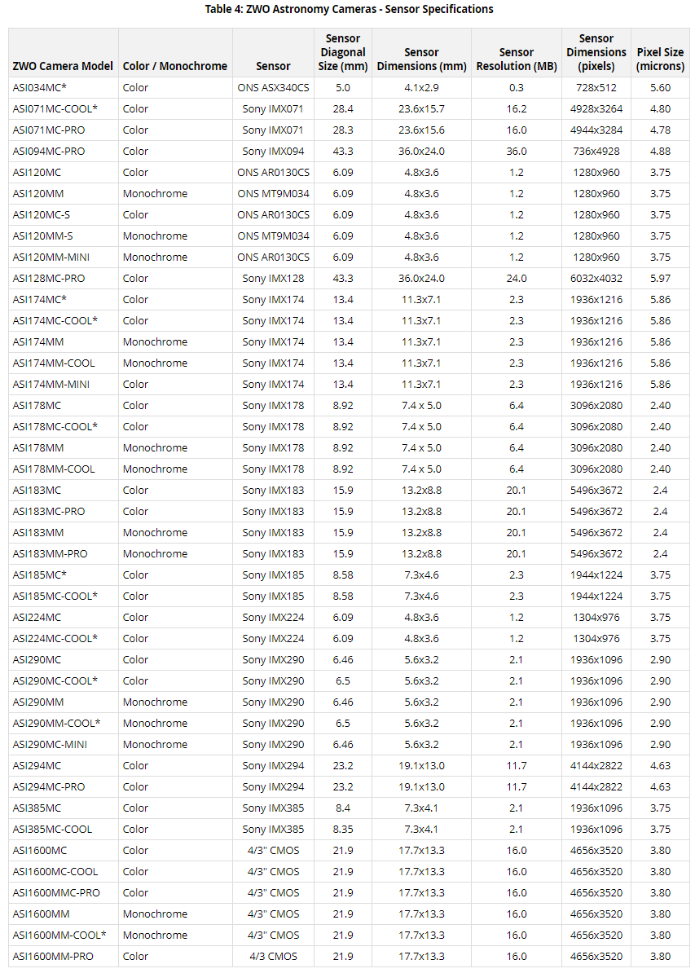
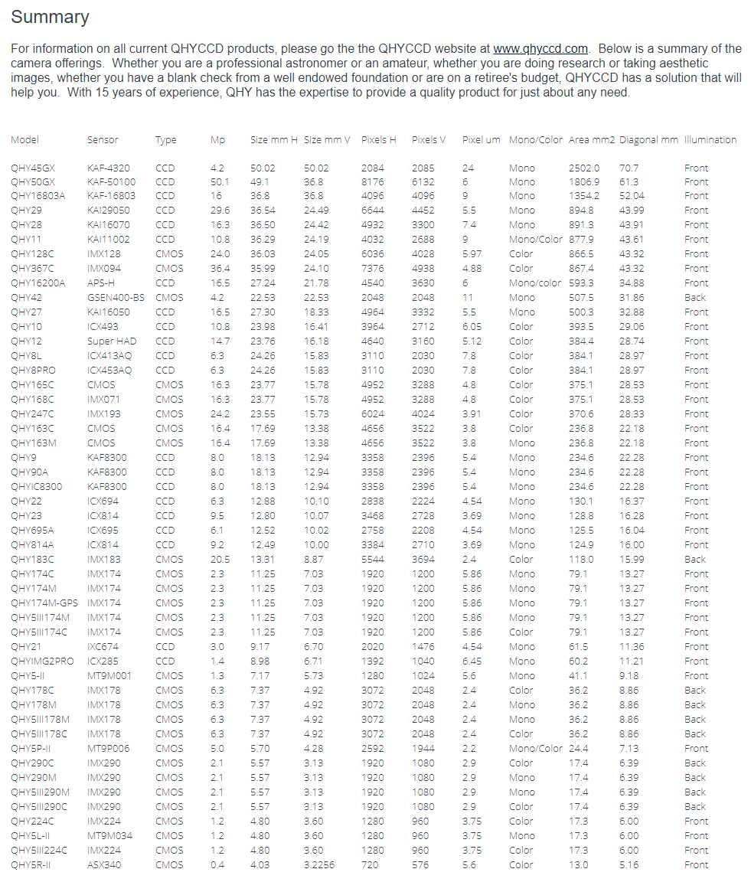
ZWO vs. QHY

Slide 26
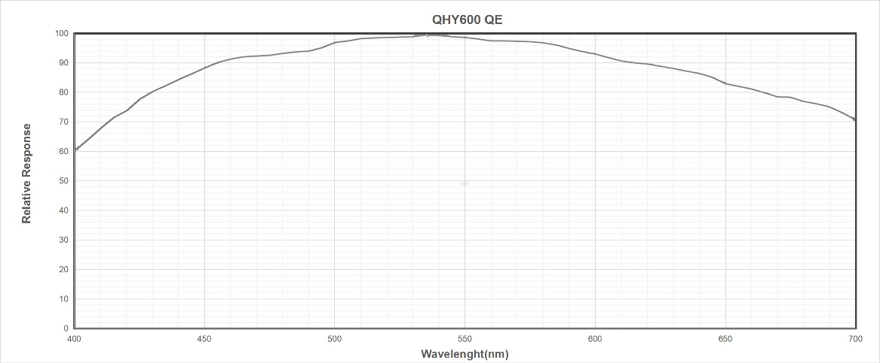
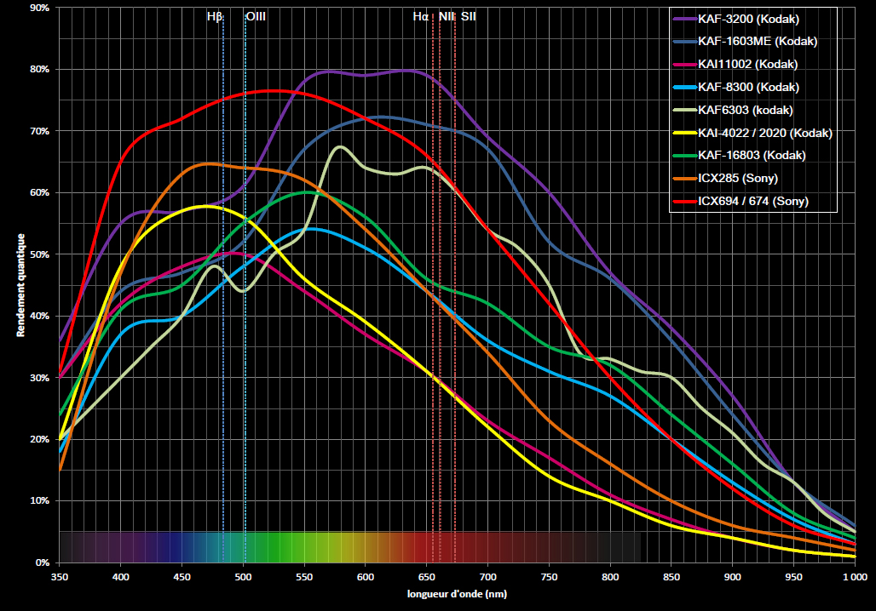
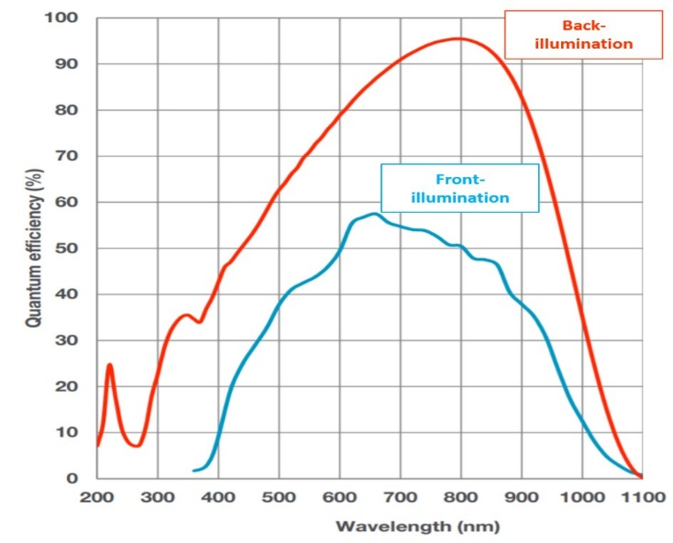
Quantum Efficiency?

Slide 27
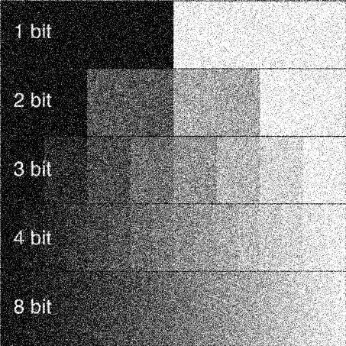
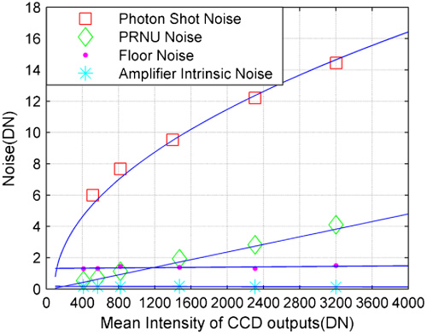
Dynamic Range vs. SNR
By definition, dynamic range is the full-well capacity divided by camera read-noise (often measured in photographic “stops”). This allows photons to be rendered as discretely as possible.
    It does not care what type of signal…it could be all light pollution for all it cares.
    You can think of it as an image’s ”potential”.
Signal-Noise Ratio (SNR), practically, is the ability to reach this potential. This is because meaningful contrast in an image is defined by the total noise contributions, not just read noise.
SNR = PQ_{e}t /(P + B)Q_{e}t + Dt + N_{r}²

Slide 28
Gain summary…
Gain is a trade-off between improving read-noise and lessening dynamic range.
    The latter is a critical point with low bit-rate cameras.
    But is read-noise a giant concern when you are “sky-limited”?
    Is read-noise a concern at all with today’s low read-noise cameras?
Realistically, other factors become important…
    Can I become “sky-limited” given my filters, dark skies, and mount?
    Do I need short-exposures because my mount cannot deliver longer ones?
    Is the sub-exposure too short?
        More time lost to dithering.
        More time lost due to processing more subs?
          Increased horsepower requirements for your PC.
          More storage!

Slide 29
Workflow 4: Total exposure time
Total exposure?
    How much is enough, especially for OIII and SII narrowband?
    Sufficient sub-frames for pre-processing?
    Is data sufficient for post-processing steps?
The goal?
    To maximize image quality in the areas where you want to render detail, typically in the shadows.
    Expose to the Right (ETTR) – make our final histograms look like terrestrial histograms…

Slide 30
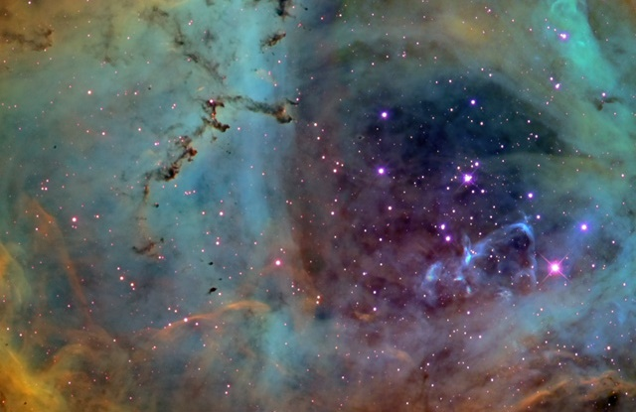
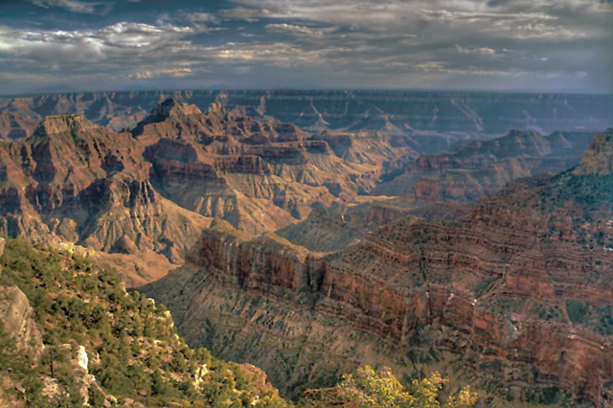
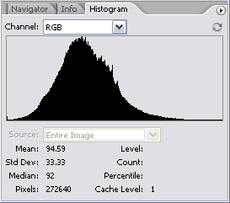
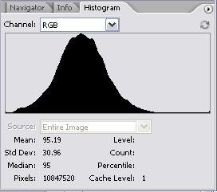
Or, as Adam Block says,
“We make every pixel count.”
What is the difference between…
…an Astrophoto…
…an earth landscape?

Slide 31
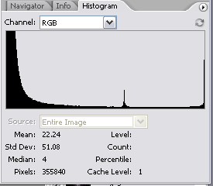
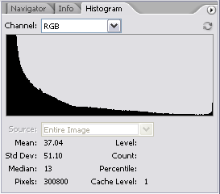
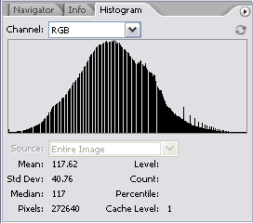
Common Histogram Faults…
Clipped Blackpoint
  Loss of data in the shadows
  You just made the background too dark, losing important data.
  For CMOS, set a proper off-set.
Clipped Whitepoint
  Oversaturation of highlights
  You just bloated stars and loss their color including color in brighter regions.
  Shorten exposure times or lessen gain.
Combing
  Missing data; insufficient dynamic range.
  You need more exposure time to gain SNR for such stretches.
  Poor DR in the sub-exposure; average more subs.
Notes:
Combing happens when you don’t have enough dynamic range to stretch out values. Common when working in 8-bit mode. Also common in images with bad S/N. Bad S/N=poor dynamic range. Combining can also occur when you stretch after performing deconvolution (sharpening), since raising local contrast will group values together and actually diminish DR. Conversely, noise removal and gaussian blurring (convolution) can help recover localized DR, and thus can restore data loss as shown in a combed histogram.

Slide 32
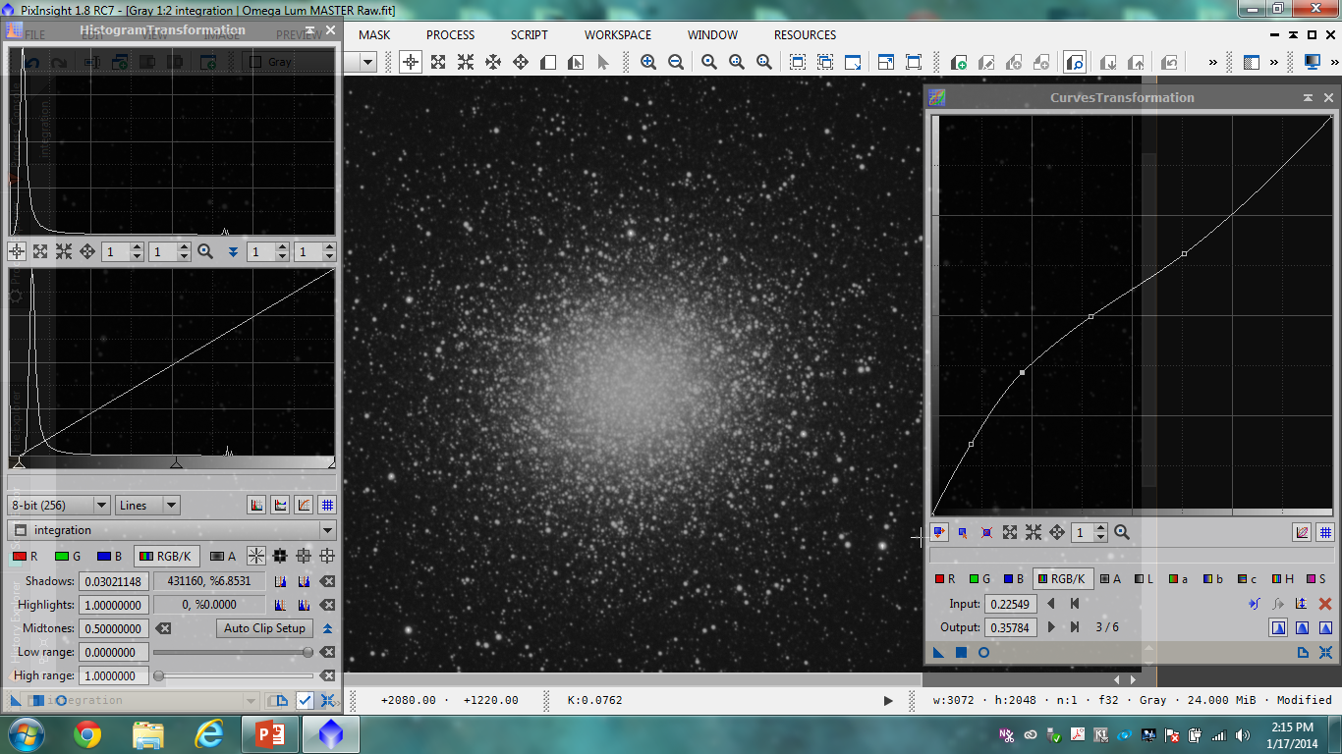
Stretch in PixInsight…

Slide 33
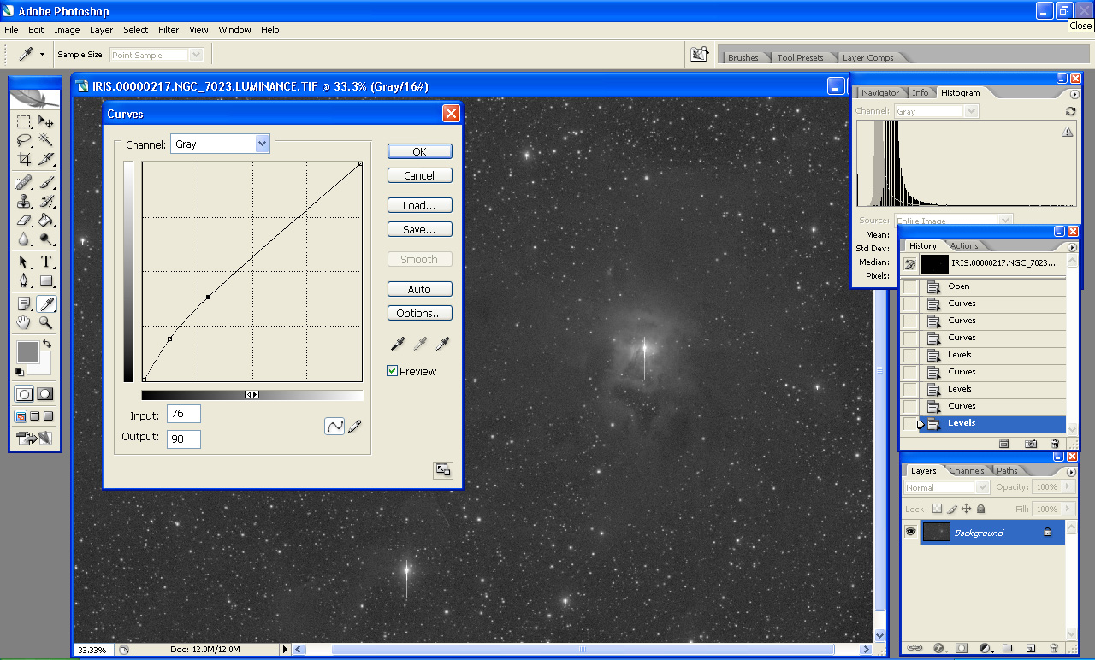
Making the Proper Curve
The type of curve is called “logarithmic,” designed to boost shadow areas yet preserve the highlights.
Work Curves and Levels in many iterations to do your own version of DDP.

Slide 34
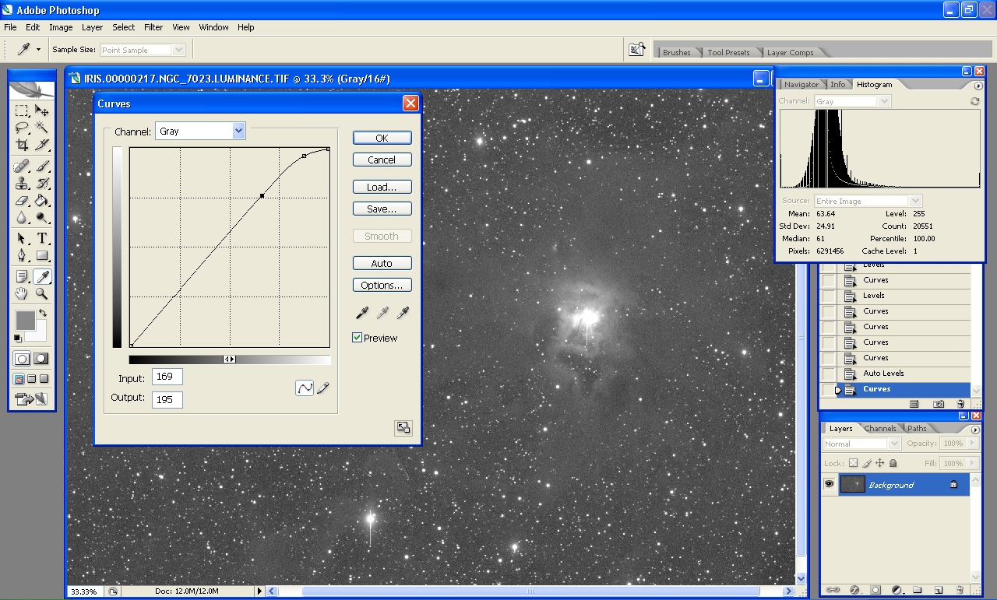
The Bad Curve
        Oversaturation of stars
        Watch the star line on the histogram
        Too bright = No color!

Slide 35
Imaging Longer…
  The central truth to this hobby - you must go long if you hope to go deep!
  Some Tips…
  Use “sky-limited” sub-exposures…use lots of them!
  Finding dark skies is imperative if you hope to make all your pixels count.
  Shoot multiple hours over multiple days
  Utilize remote PC control
  Take naps and/or have other forms of fun!

Slide 36
Acquisition workflow summary…
1. Gear choices, environment, and setup
    Narrowband vs. OSC vs. grayscale
    Auto-guiding or unguided?
    Dithering?
2. Calibration frames
    Scaling darks with bias frames for CCDs
    Non-scaled darks for CMOS sensors
    Are darks useful or practical? Cooling set-point?
    Effectiveness of flat-field? Is it worth it?
3. Light frames
    Swamping read noise…
    Prevent oversaturation of highlights
4. Total exposure?
    How much is enough, especially for OIII and SII narrowband?
    Sufficient sub-frames for pre-processing?
    Is data sufficient for post-processing steps?

Slide 37
Questions???
For More Information…
  See www.allaboutastro.com for more of Jay’s images and articles…
  See www.3rf.org to learn about our astronomy efforts in Northwest Texas…

